Slide 1
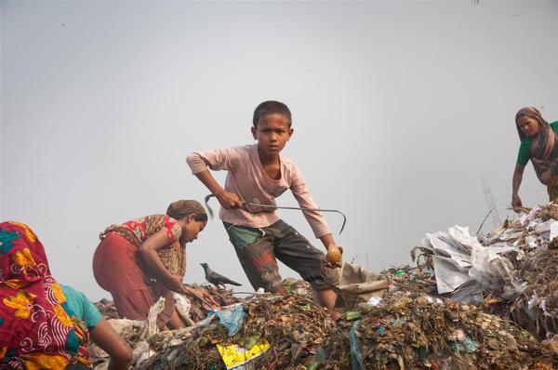



CHILD LABOUR: 2020 GLOBAL ESTIMATES THE ROAD FORWARD

Slide 8
Economic empowerment,
livelihoods, and business
Make social protection universal.
Expand decent work and Accelerate transition to formality.
Improve rural livelihoods.
Reduce heightened risks of child labour in domestic and global supply chains.

Slide 9
Education, Protection, and
Social Norms
Safeguard and advance children’s education.
Register the birth of every child.
Strengthen Child Protection Systems.
End gender norms and discrimination.
Change social and cultural norms perpetuate child labour, with focus on gender.

Slide 10
Evidence, Policy, and
International Cooperation
Adopt adequate legal frameworks and promote compliance.
Strengthen evidence and make child labourers visible .
Address child labour in conflicts, disasters and other crises.
Realize the promise of international cooperation and partnership.

Slide 11
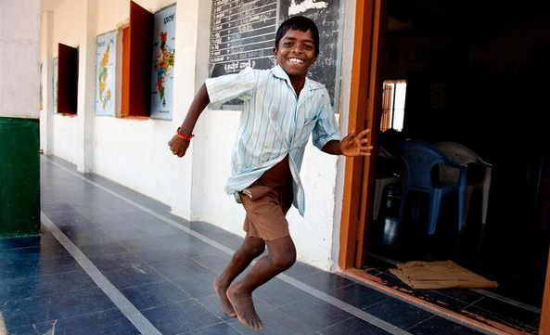

THANK YOU

