Slide 1

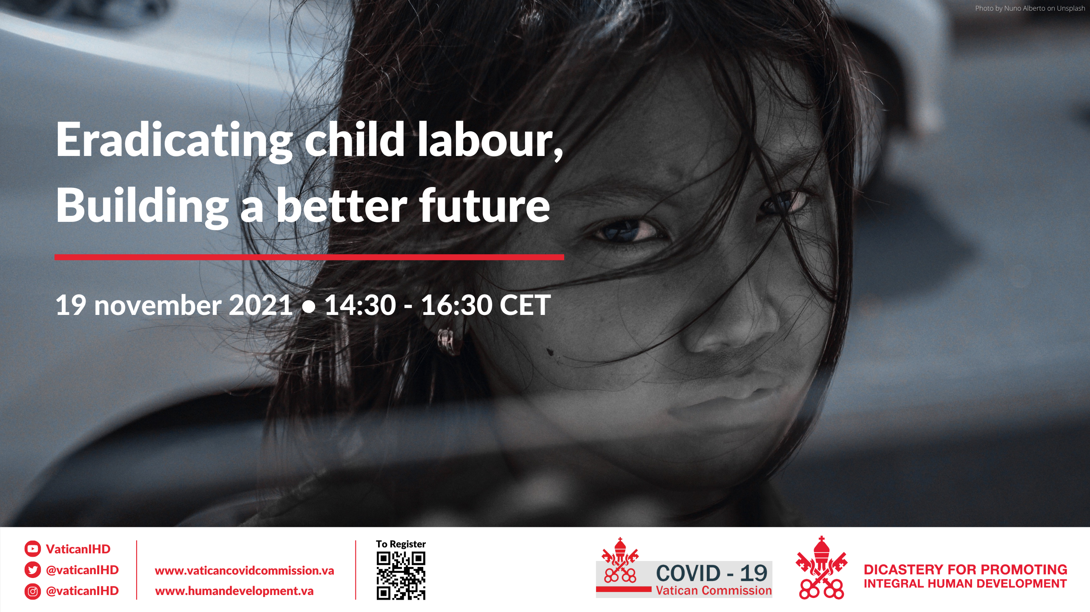

Cooperation and partnerships to end child labour
Ana López Castelló and Gianni Rosas, International Labour Office

Slide 2

Cooperation and partnerships to end child labour
Inclusive cooperation and broad-based partnerships are required at the global, regional, national and local levels to reach the goal of eliminating child labour. These arrangements can address the root causes and find solutions that are more effective than those of any single actor.
Global and regional partnerships. Allow for (i) mobilizing support and action across countries, (ii) sharing knowledge and expertise, and (iii) finding solutions to issues that go beyond national borders (e.g. child labour in global supply chains).
National partnerships. Cooperation, coordination of activities across a variety of government entities, the social partners, civil society organizations and public-private partnerships are key to the design and delivery of effective policies and programmes that aim to put an end to child labour and promote decent work of young people and adults.
Local level and community-based partnerships. Partnerships and effective cooperation among local authorities, employers, services and community-based organizations foster an environment of trust and galvanize action grounded on the knowledge of the local context and of children themselves.

Slide 3
Alliance 8.7
An inclusive global partnership for immediate and effective action to eradicate child labour and other forms of unacceptable work (forced labour, human trafficking) with the view of achieving Target 8.7 of the 2030 Agenda.
Pathfinder countries
26 countries committed to go faster in the achievement of Target 8.7 with new approaches and collaborative endeavours, including through (i) new or improved legislation, (ii) concrete action (national action plans or policies), and/or (iii) ratification of applicable international human rights and labour standards
Partners
242 partners including governments, international and regional organizations, workers’ organizations, employer and business membership organizations, civil society, academic institutions

Slide 4
Alliance 8.7: Expected results
Accelerate action. Measurable strategies, national plans and budgets to achieve Target 8.7, including through cooperation with employer and worker organizations and other concerned groups.
Research and knowledge sharing. Production and dissemination of research, knowledge and expertise to support policymakers and other stakeholders to adopt policies and measures that are based on evidence, including through the use of knowledge platforms (e.g. Delta 8.7).
Innovation and resources. Identification of innovative ways to tackle child labour and other unacceptable forms of work, including through the use of technology and social innovation. Leveraging of resources and funding for action-oriented solutions, including through South-South and triangular cooperation and other development cooperation mechanisms at national, regional and global levels.

Slide 5

Iniciativa Regional América Latina y el Caribe Libre de Trabajo Infantil
30
Autoridad de Alto Nivel
Conformada por Ministros y Ministras de Trabajo de países miembros
Antigua y Barbuda
Argentina
Bahamas
Barbados
Bolivia
Brasil
Chile
Colombia
Costa Rica
Cuba
Ecuador
El Salvador
Granada
Guatemala
Guyana
Haití
Honduras
Jamaica
México
Nicaragua
Panamá
Paraguay
Perú
República
Dominicana
Saint Kitts y Nevis
Santa Lucía
Surinam
Trinidad y Tobago
Uruguay
Venezuela
7
7
Representantes regionales
de organizaciones
de empleadores
Representantes regionales
de organizaciones
de trabajadores
Red de Puntos Focales
Conformada por representantes de gobiernos, organizaciones de empleadores y de trabajadores
1
Encargada a la Oficina Regional de la OIT para América Latina y el Caribe
Secretaría Técnica

Slide 6
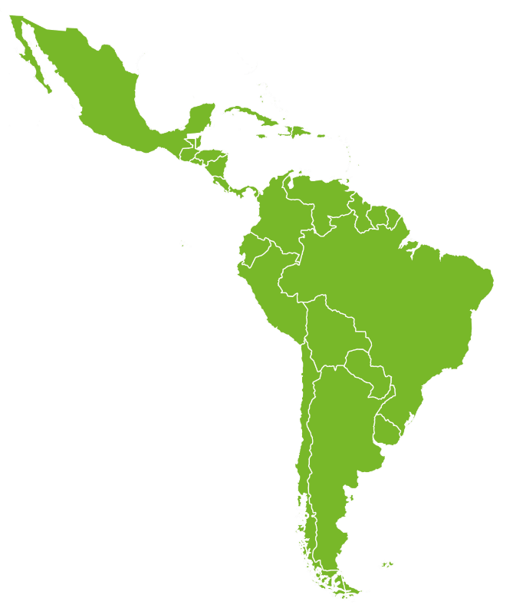

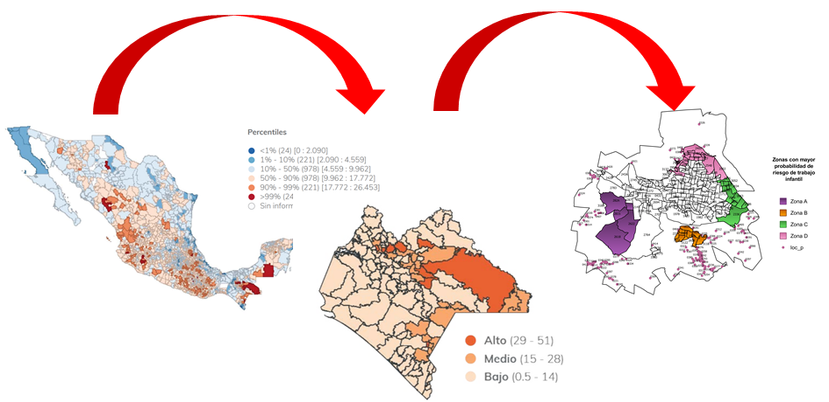
Territorialización de la meta 8.7
Dimensión nacional y local
Implementación de políticas
Intercambio y fortalecimiento de capacidades
No dejar a nadie atrás en el logro de la meta 8.7

Slide 7
Modelo de Identificación del Riesgo de Trabajo Infantil- MIRTI:
Políticas locales de prevención
Diseñar e implementar estrategias preventivas de trabajo infantil a nivel local.
Implementado en 10 países: Argentina, Brasil, Chile, Colombia, Costa Rica, Guatemala, Jamaica, México, Perú y Paraguay.
Estimación de la vulnerabilidad al trabajo infantil en 12.464 municipios, identificando los factores de protección y riesgo.

Slide 8
Contact/contacto
International Labour Office
Oficina Internacional del Trabajo
Fundamental Principles and Rights at Work Branch
Servicio de Principios y derechos fundamentales en el trabajo
Email: fundamentals@ilo.org
Web : www.ilo.org/fundamentals; www.alliance87.org.

